Slide 1

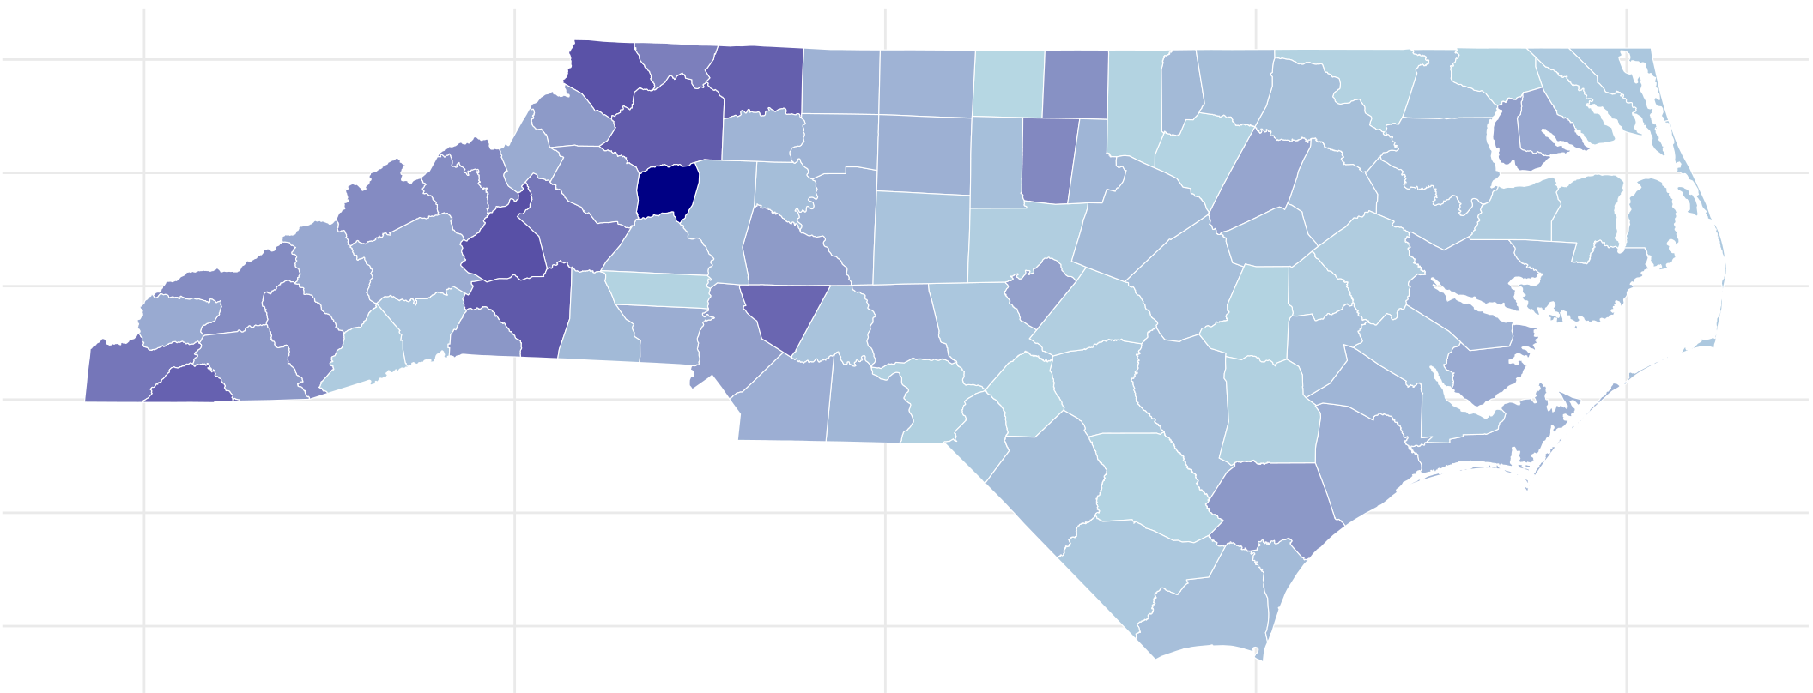
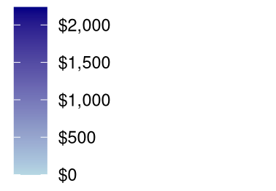
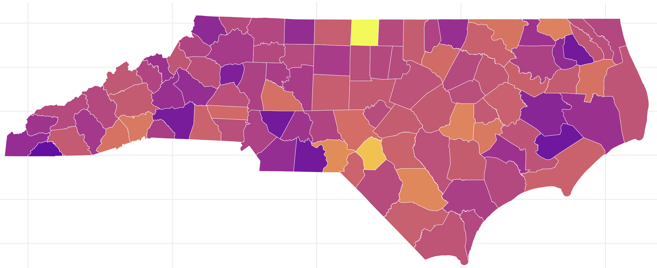
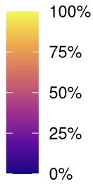
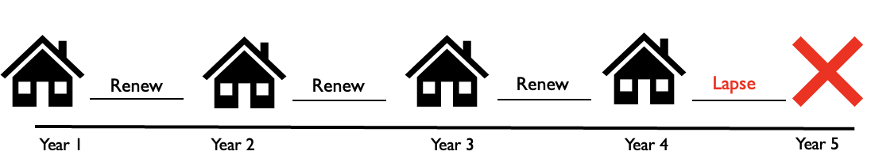
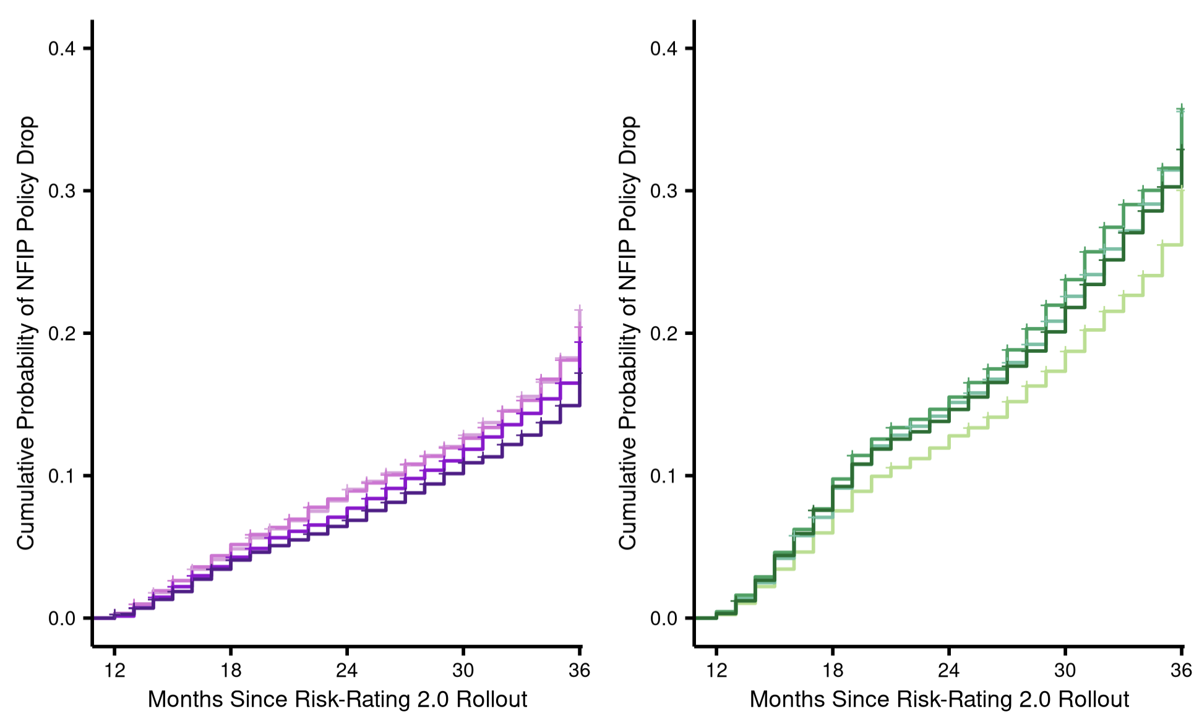
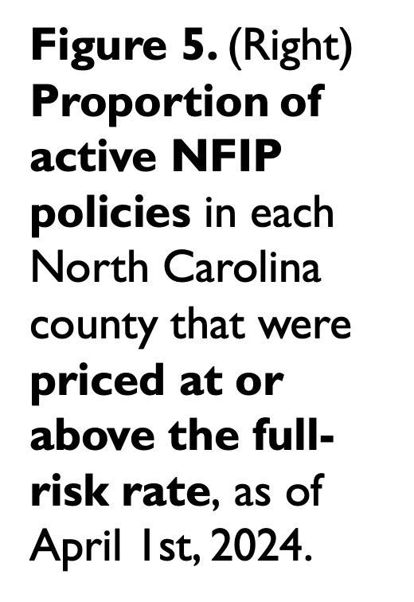
Risk Rating 2.0 and the Affordability and Uptake of Flood Insurance in North Carolina
Risk Rating 2.0 and the Affordability and Uptake of Flood Insurance in North Carolina
Olivia L. Payne (oleigh@unc.edu), Environmental Studies and Public Policy, Class of 2027
Kieran P. Fitzmason, Harrison B. Zeff, Gregory W. Characklis, Antonia Sebastian
Olivia L. Payne (oleigh@unc.edu), Environmental Studies and Public Policy, Class of 2027
Kieran P. Fitzmason, Harrison B. Zeff, Gregory W. Characklis, Antonia Sebastian
Background
Preliminary Results
Broader Impacts
The National Flood Insurance Program (NFIP) has focused on affordability rather than actuarial solvency, leading to a shortfall in revenue and insufficient funding to pay claims.
Risk Rating 2.0 aims to make the NFIP more actuarially sound by addressing the gap that exists between the actual flood risk a property possesses, and the flood risk reflected within the legacy premium of the property.
This change prompts significant premium increases for many NFIP policyholders. Increases are capped at a maximum of 18% per year by federal statute.
This research seeks to quantify how flood insurance affordability and uptake will change in North Carolina post-implementation of the Risk Rating 2.0 methodology.
Flood insurance penetration has profound financial implications for local governments, who are essential actors in post-disaster relief distribution and the integration of community flood resilience mechanisms.
Concentrated lack of flood coverage diminishes the revenue a local government can collect through property taxes, which harms their ability to provide essential services.
Lenders experience greater financial vulnerability when flood insurance prices increase because property values will start to decrease, which decreases collateral.
If policyholders drop their coverage because they cannot afford it, they are more likely to sustain uninsured damages when the next flood occurs.
Data
Median Premium Increase ($)
Future Work
Figure 4. (Above) Map visualizing the median NFIP premium increase in North Carolina by county, as of April 1st, 2024. Calculated by subtracting the median full-risk premium in each county from the median legacy premium in each county. Darker blues correspond to higher increases in premium, which are concentrated in Western North Carolina. The statewide median NFIP premium increase was $316.00.
Individual policyholder example (≤80% AMI):
Policyholder HHI: $40,000
AMI: $80,000
Premium: $900
HHI: household income
AMI: area median income
MBA: means–based assistance
MHI: median household income
Premium reaches projected actuarially sound rate
Potential inflationary increases
% of NFIP Policies at Full-Risk
Figure 5. (Right) Proportion of active NFIP policies in each North Carolina county that were priced at or above the full-risk rate, as of April 1st, 2024.
Increasing at the maximum of 18% per year
Increasing at the maximum of 18% per year
$400 Paid by Policyholder
Figure 1. Increases faced by a hypothetical new NFIP policyholder during the rollout of Risk Rating 2.0.
Inside SFHA
Outside SFHA
Figure 6. (Left) Cumulative probability that an NFIP policyholder will drop their coverage as time extends post-rollout of Risk Rating 2.0. Flood insurance is mandatory for properties with a federally backed mortgage within the the Special Flood Hazard Area (SFHA), defined by FEMA as areas with a 1% or greater chance of flooding in a year.
% Increase in Premium:
% Increase in Premium:
Figure 7. Hypothetical Means-Based Assistance Program where coverage is based on amount of premium that exceeds a certain percentage of household income. Restricted eligibility for policyholders whose household income is below a certain percentage of the AMI.
0-8% (n = 20401)
0-8% (n = 16256)
Figure 2. The 4-year period exemplified above would be assigned one unique stint ID, representing a single period of continuous coverage.
>8-40% (n = 5853)
>8-40% (n = 7650)
>40-150% (n = 15144)
>40-150% (n = 11203)
>150% (n = 7013)
>150% (n = 17095)
Acknowledgements
01/01/2009
04/01/2022
04/01/2023
05/01/2025
Thank you to everyone at UNC’s Institute for Risk Management and Insurance Innovation and UNC’s Flood Hydrology and Hazards Lab for the opportunity to pursue this project, and for your generous guidance throughout.
Type 1
Type 2
References
Figure 3. Two policyholder types were used throughout the analysis. Both Type 1 and Type 2 policyholders held an NFIP policy before the rollout of Risk Rating 2.0. Type 2 policyholders terminated their policy after their first renewal into the new pricing system.
Government Accountability Office (2023). FEMA’s New Rate-Setting Methodology Improves Actuarial Soundness but Highlights Need for Broader Program Reform.
Gourevitch et al. (2025). Effects of Risk-based Pricing Reform on Flood Insurance Uptake.

